Slide 1

Banking analytics - predict customer subscription
Raghu Raman Nanduri
DSC 680

Slide 2
Business Understanding:
We all know that, the best way to grow a business is by retaining existing customers and then acquire new customers. That’s why most of the companies give importance to retain existing customers and increase their presence by cross selling other products to them.
The business objective of this project is to analyze the success rate in customer retention through direct campaign marketing by a Portuguese Bank for which this data set pertains to. It is important to find what parameters define the outcome of the direct campaign and what parameters are a must for a positive outcome leading to a subscription. In order to increase the chance of their success, if a bank can predict who are the customers that are most likely to subscribe for their new program (here the program is term deposit).
Business Goal:
In terms of modelling perspective, the business goal is to define a predictive model involving binary classification of customers into 2 categories –
1) Customers that might open term deposit account with the bank after the campaign.
2) Customers that will not open term deposit account with the bank.
This classification really helps banks to identify the customers that they can concentrate their campaigning resources on such that it gives them maximum chance to succeed in their campaign resulting in more term deposit accounts (indirectly increasing their program’s success rate).

Slide 3
Data Understanding:
Dataset is available on openml.org. Download the data set and place it in the appropriate directory.
The data set consists of direct marketing campaigning results from a Portuguese bank. The direct campaigning involves their existing customers that have either an account with some balance or personal loan or a housing loan. The data set includes the demographic information about such customers like their job status, marital status, educational details. It also includes direct call campaigning details like contact type, day & month of contact, how long the telephonic conversation took place along with previous campaigning results. As data set involves, only phone calls my research includes the effectiveness of the direct marketing campaign.
Complimentary Data Sources:
No complimentary data sets are considered for this project as the data set seemed very tailor made.
Project Link:
Project related analysis can be found in “Banking Analytics” section of my portfolio site, mentioned below.
https://iamnrr.github.io/

Slide 4
Exploratory Data Analysis

Slide 5
Feature Variables: There are 16 input variables, out of which some are categorical, and some are numeric. Below is the entire list
1 - age (numeric)
2 - job : type of job (categorical: "admin.","unknown","unemployed","management","housemaid","entrepreneur", "student","blue-collar","self-employed","retired","technician","services")
3 - marital : marital status (categorical: "married","divorced","single"; note: "divorced" means divorced or widowed)
4 - education (categorical: "unknown","secondary","primary","tertiary")
5 - default: has credit in default? (binary: "yes","no")
6 - balance: average yearly balance, in euros (numeric)
7 - housing: has housing loan? (binary: "yes","no")
8 - loan: has personal loan? (binary: "yes","no")
related with the last contact of the current campaign:
9 - contact: contact communication type (categorical: "unknown","telephone","cellular")
10 - day: last contact day of the month (numeric)
11 - month: last contact month of year (categorical: "jan", "feb", "mar", ..., "nov", "dec")
12 - duration: last contact duration, in seconds (numeric)
other attributes:
13 - campaign: number of contacts performed during this campaign and for this client (numeric, includes last contact)
14 - pdays: number of days that passed by after the client was last contacted from a previous campaign (numeric, -1 means client was not previously contacted)
15 - previous: number of contacts performed before this campaign and for this client (numeric)
16 - poutcome: outcome of the previous marketing campaign (categorical: "unknown","other","failure","success")

Slide 6
Target Variable:
Only one variable that needs to be predicted that is the customer’s classification, it is Boolean type with yes/no.
Yes, means the customer has subscribed for the term deposit and No, means the customer did not subscribe.
The actual data set has values 1 & 2 which were modified as 0 & 1 based on the below assumptions.
Assumptions
Due to lack of clarity in the code book and misrepresentation of the binary variable – class with values 1 & 2, I had to make below assumptions:
1) The value ‘1’ represents binary ‘no’ and hence replaced it with numeric 0.
2) The value ‘2’ represents binary ‘yes and hence replaced it with numeric 1.

Slide 7


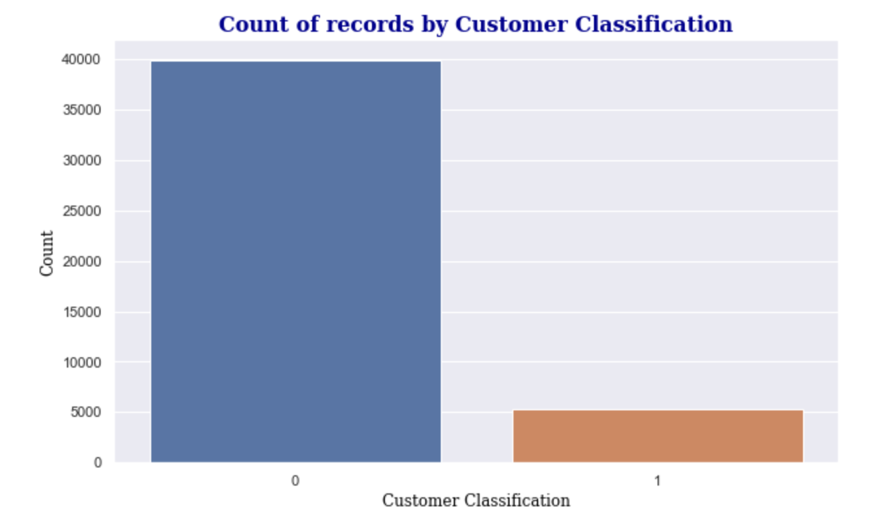
Unbalanced classes.

Slide 8
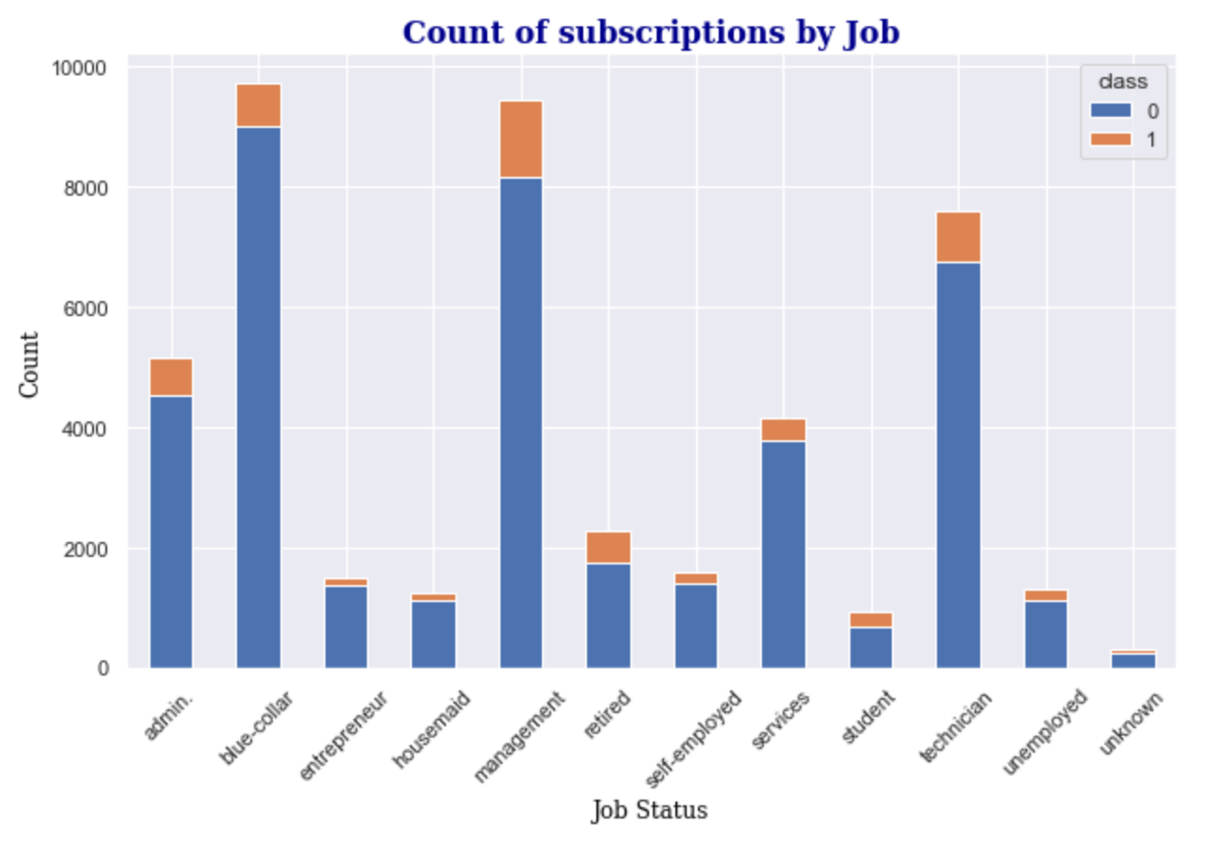
Top 3 job statuses among the current customers are blue-collar, management, and technician.

Slide 9
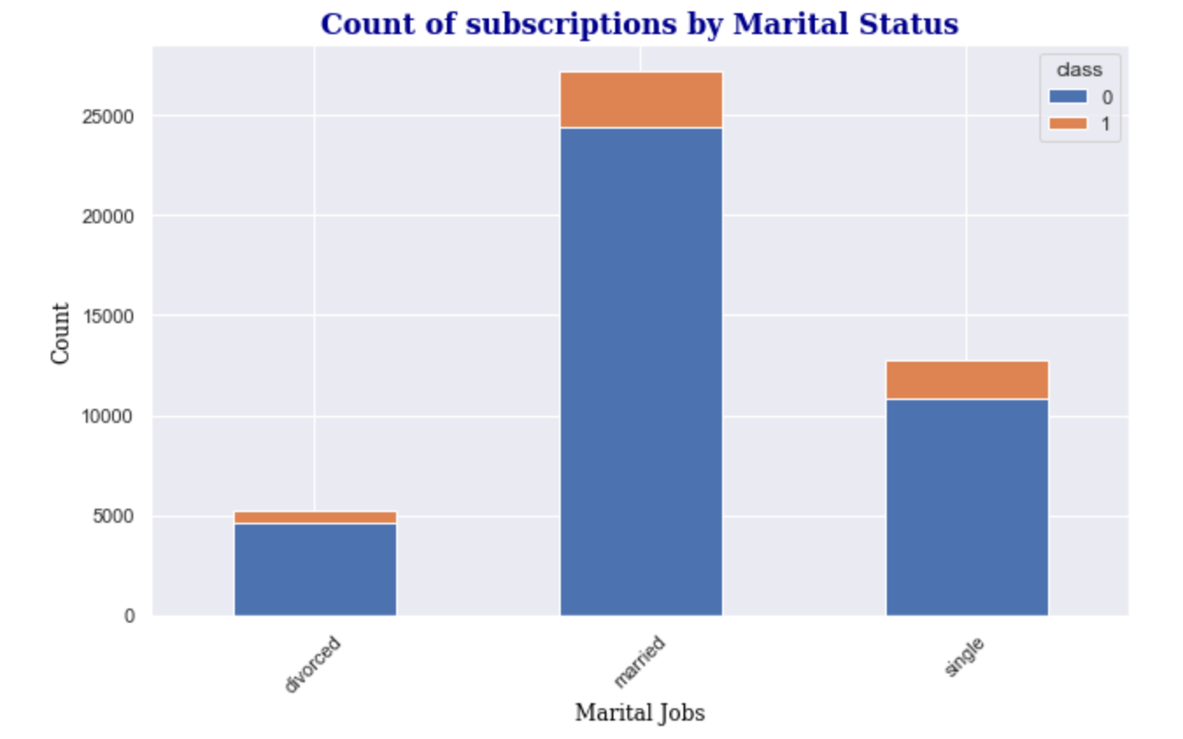
Most of the current customers are married as depicted in below bar plot.

Slide 10
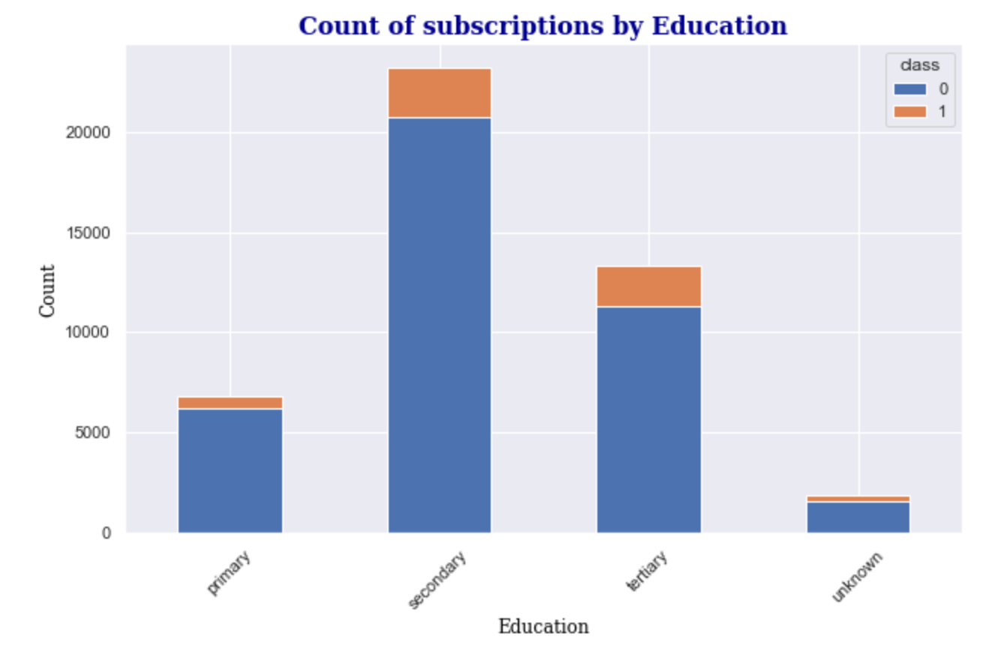
Most of the customers have at least secondary education and tertiary education.

Slide 11
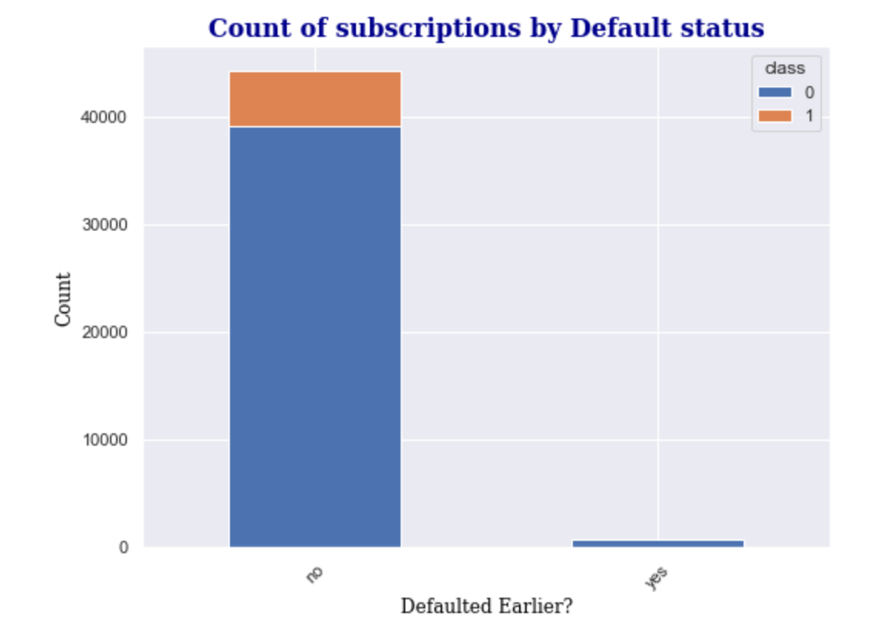

Slide 12
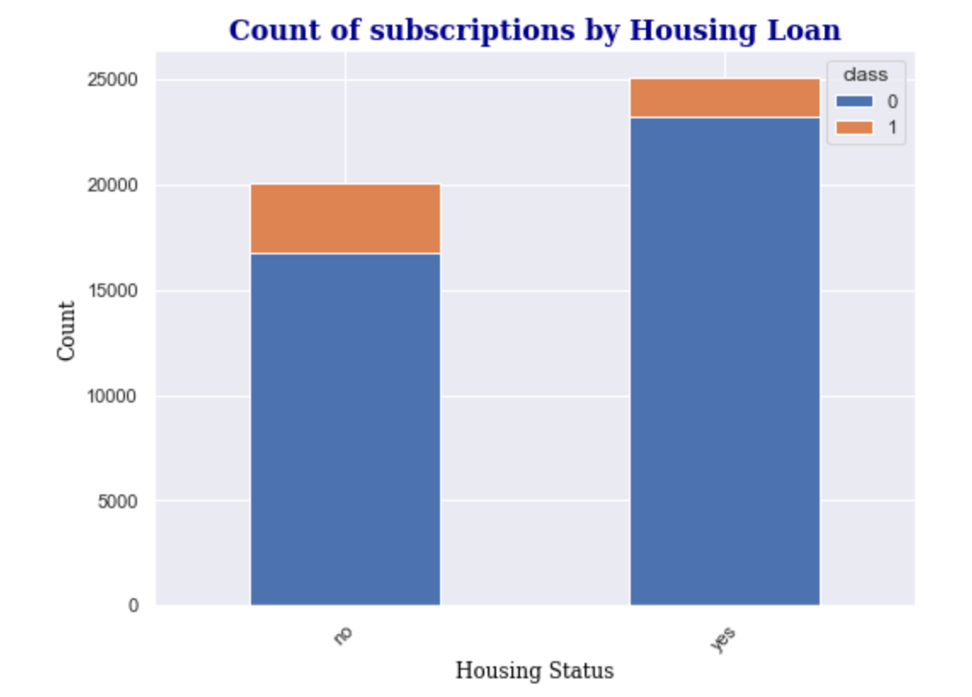
Most of the current customer bunch does have housing loan with the bank and looks like customers that do not have housing loan with the bank are more likely to subscribe for term deposit.

Slide 13
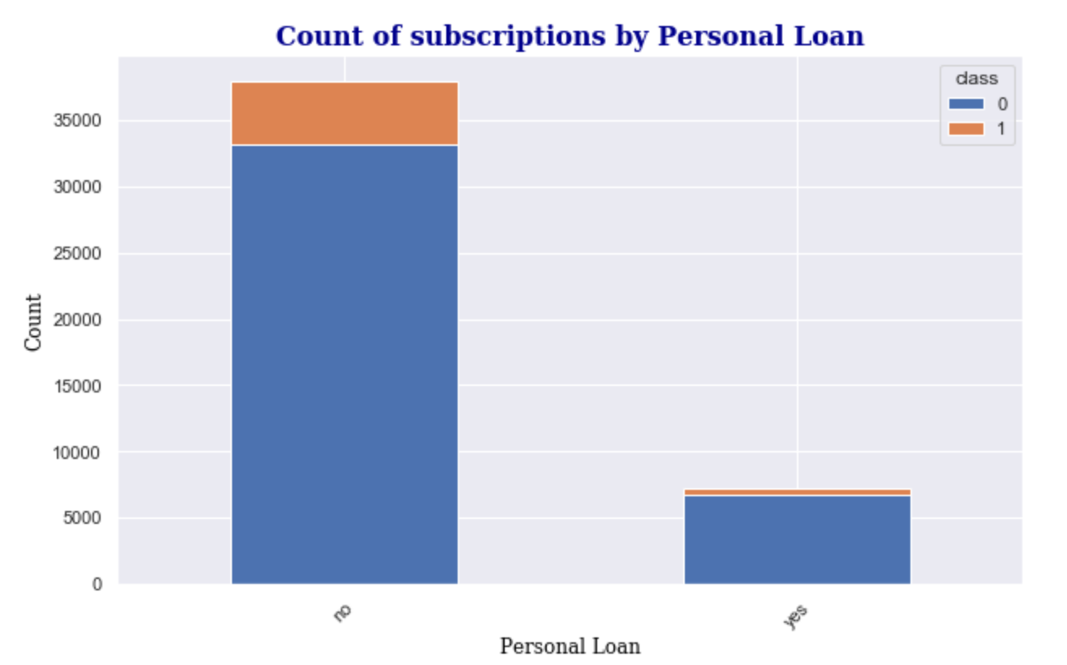
Most of the current customer bunch does not have personal loan with the bank and looks like customers that do not have personal loan with the bank are more likely to subscribe for term deposit.

Slide 14
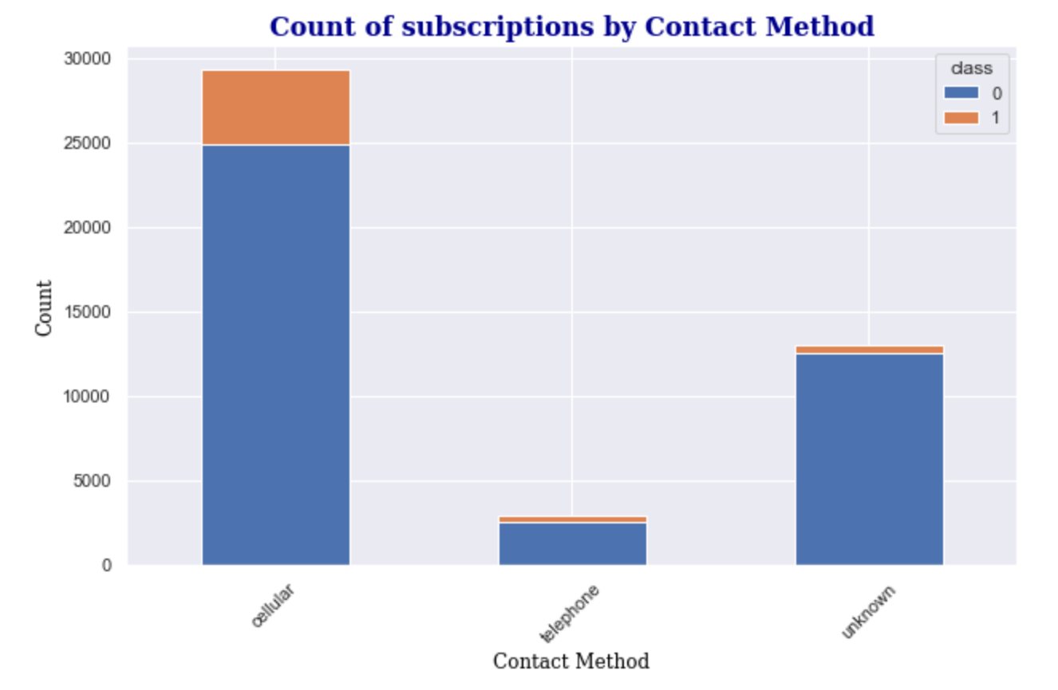

Slide 15
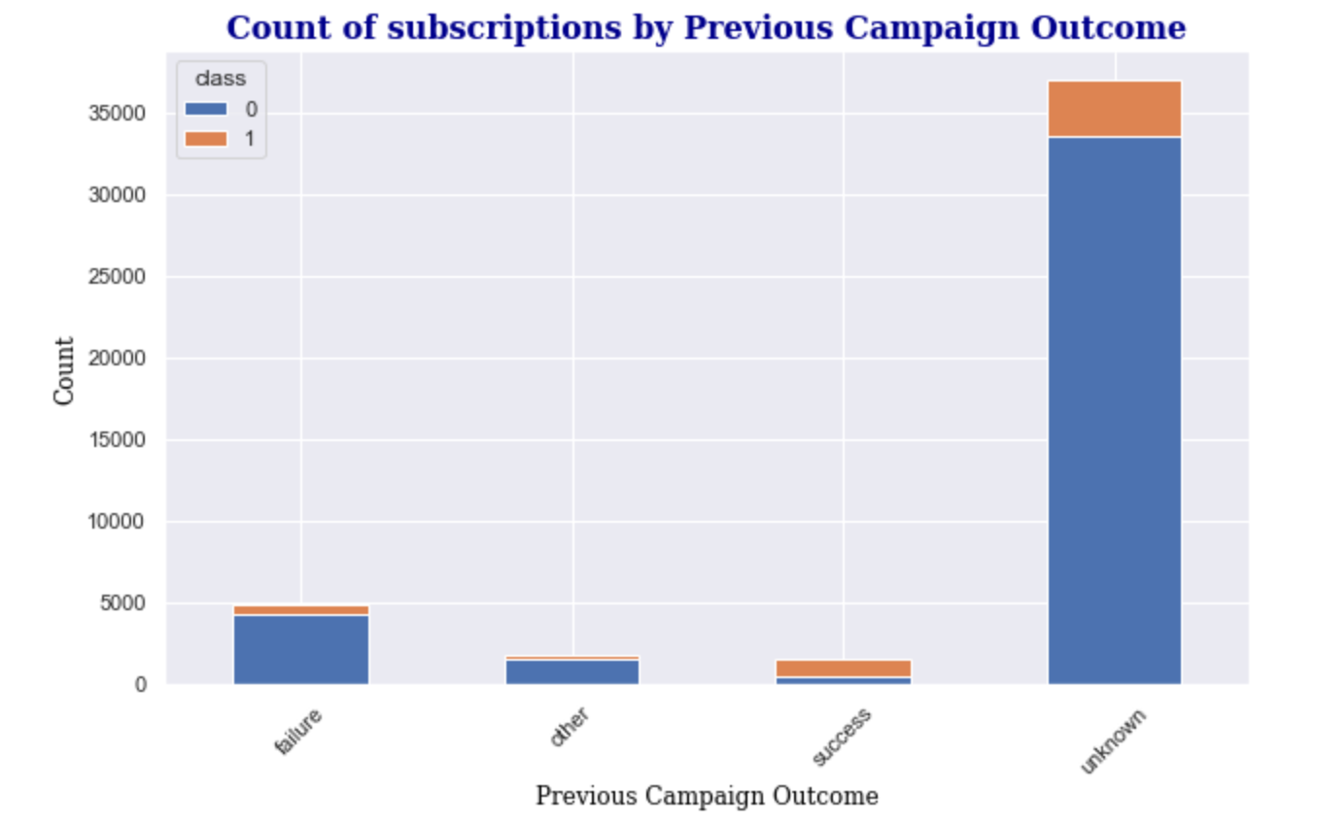

Slide 16
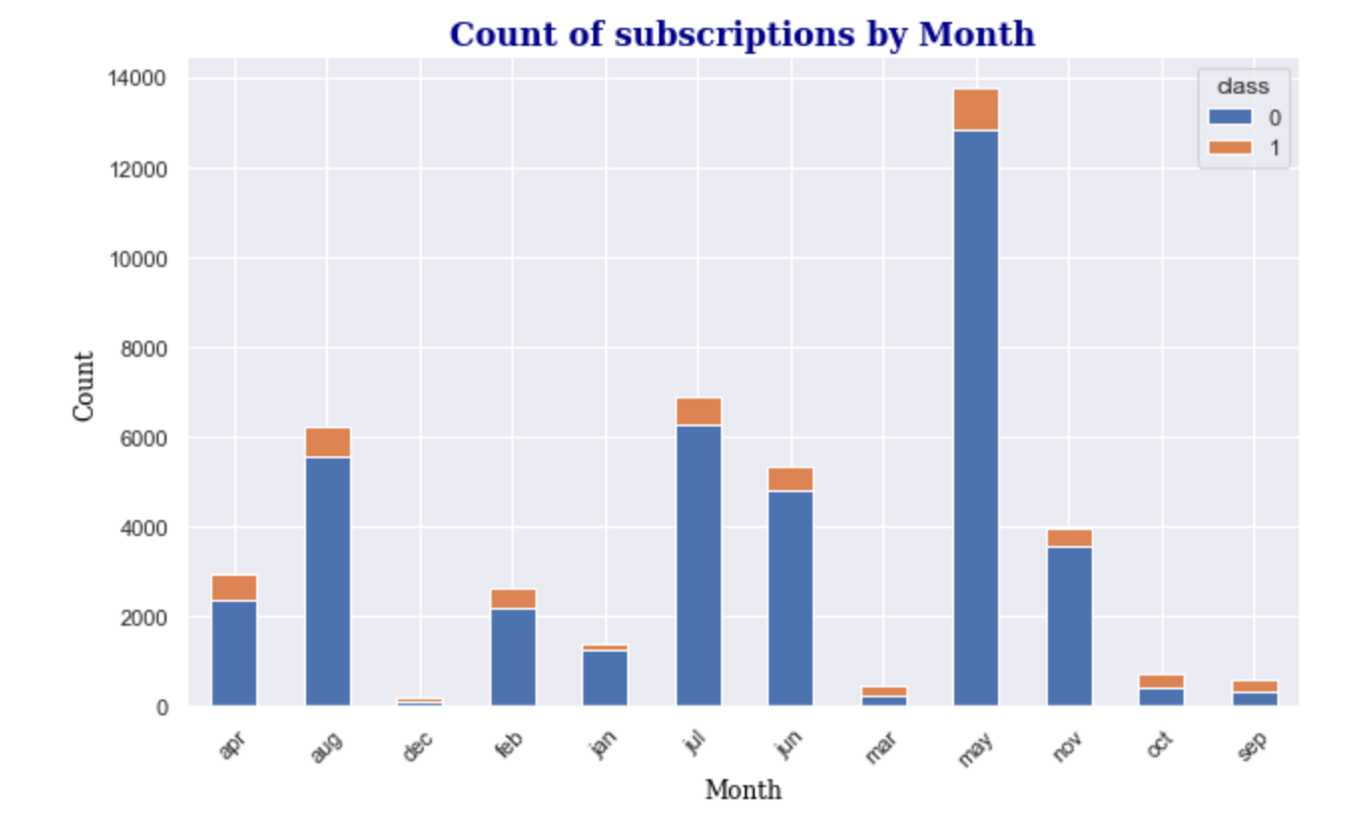

Slide 17
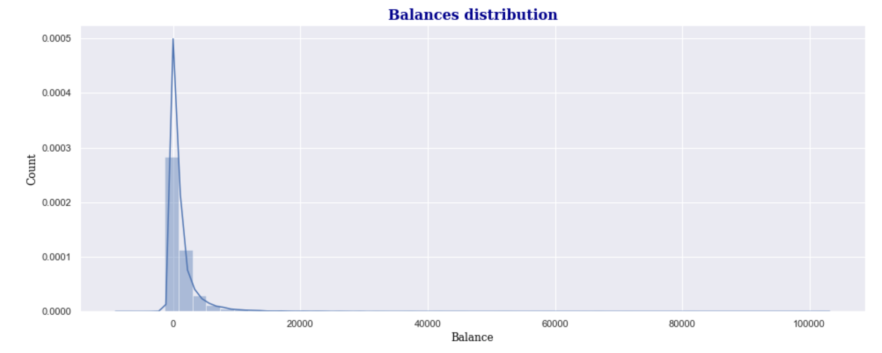
Balance distribution of the banks current customers is highly skewed with long tail towards higher end of the scale. We can infer that most of the current customers maintain less than 10,000 balance.

Slide 18
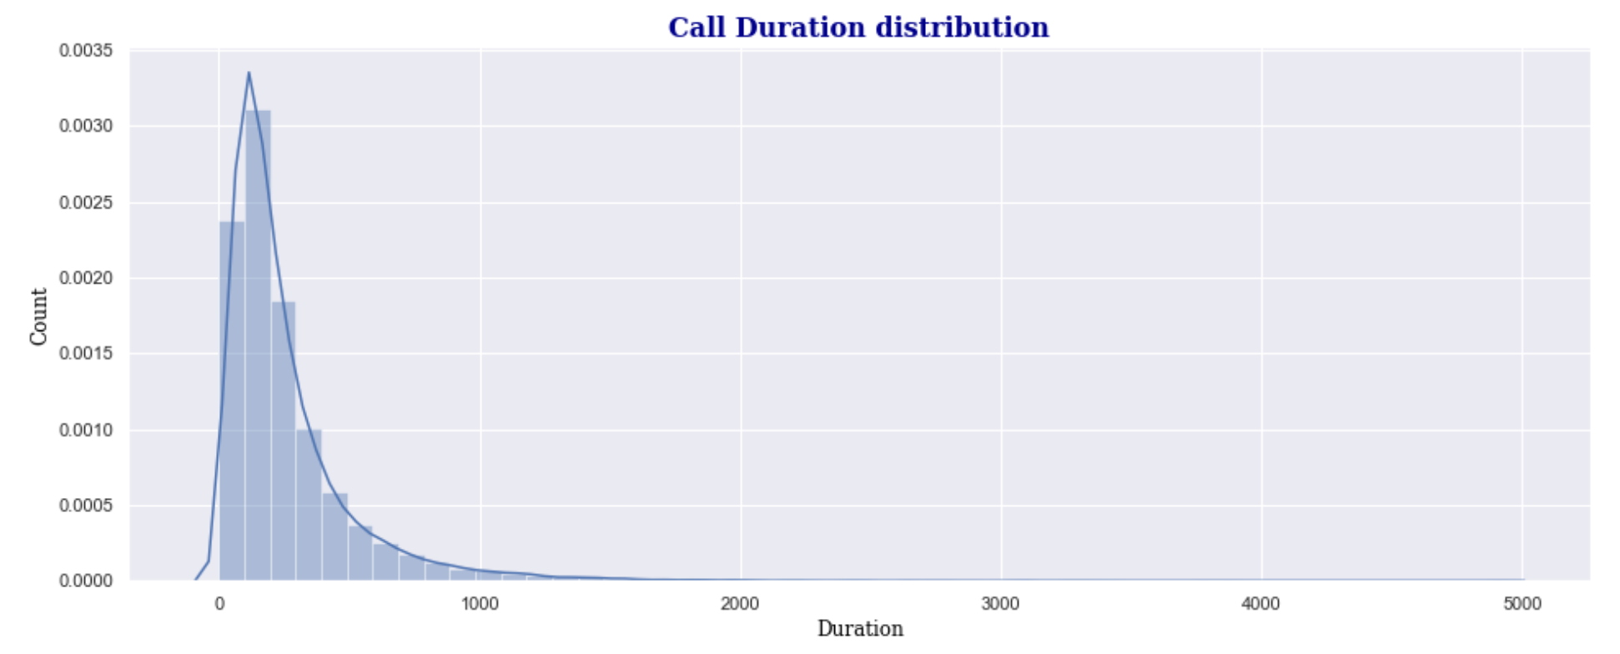
Most of the current customers have spoken for less than 500 seconds during the last call campaign. Which means, the campaign representatives on average must spend less than 10 minutes, to get to know either the customer is interested or not in subscribing to term deposit program.

Slide 19
Feature Selection

Slide 20
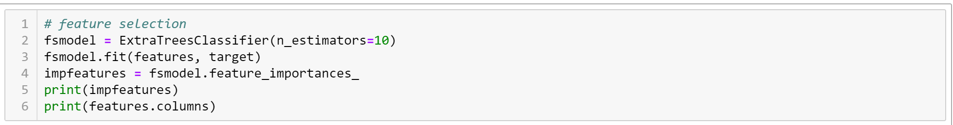
Extra Trees Classifier (Extremely Randomized Tress):
Random split of random subset features
Bootstrap = False, samples without replacement
Low Variance

Slide 21
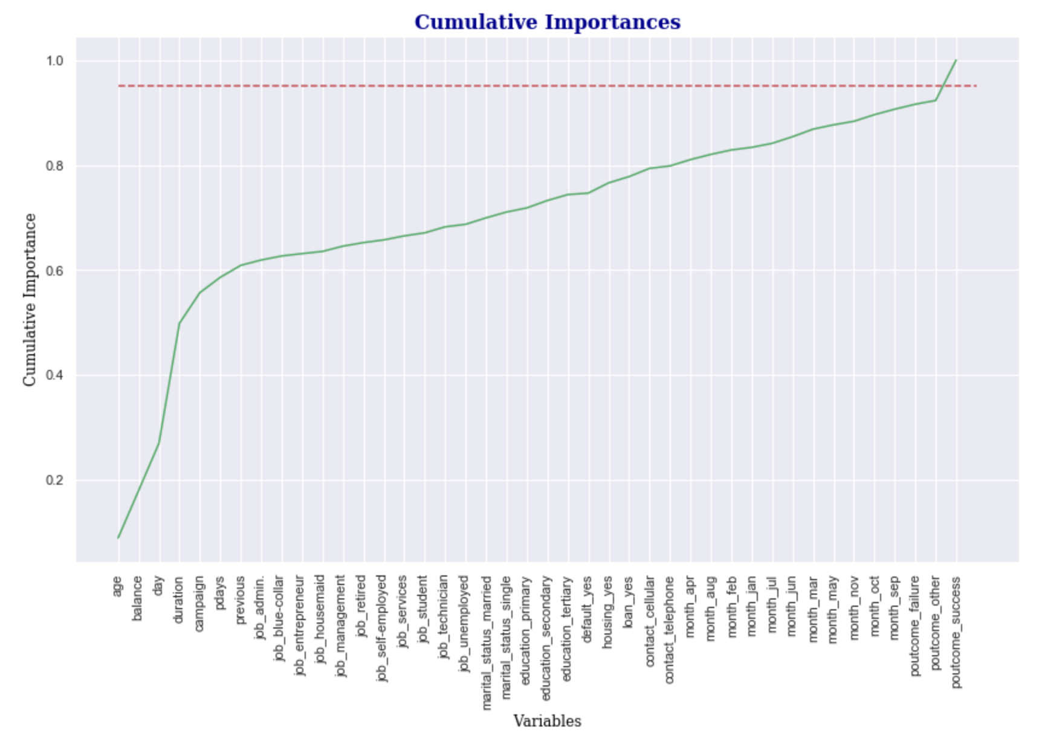

Slide 22
Predictive Modeling

Slide 23
Why Random Forest?
Random Forest is an ensemble of decision trees.
1) To begin with, our data has unbalanced classes and Random Forest handles unbalanced data well by minimizing the overall error rate.
2) At each random split of decision tree, the model picks random subset of features, which reduces the correlation between the features selected improving the variance of the model.
3) Random Forest is not affected with the presence of outliers and non- linear data. In the exploratory data analysis, we have observed that the variable ‘balance’ has outliers. By selecting Random Forest, the presence of outliers is negated.

Slide 24
Model Training

Slide 25
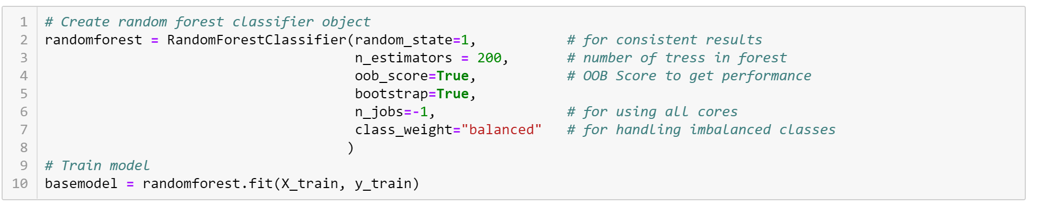
Base model with 200 estimators (number of trees), class weight = balanced

Slide 26
Model Evaluation

Slide 27
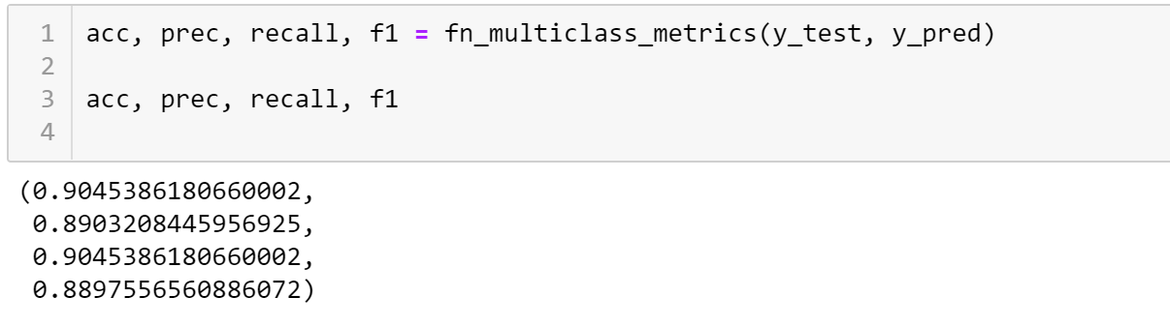

Slide 28
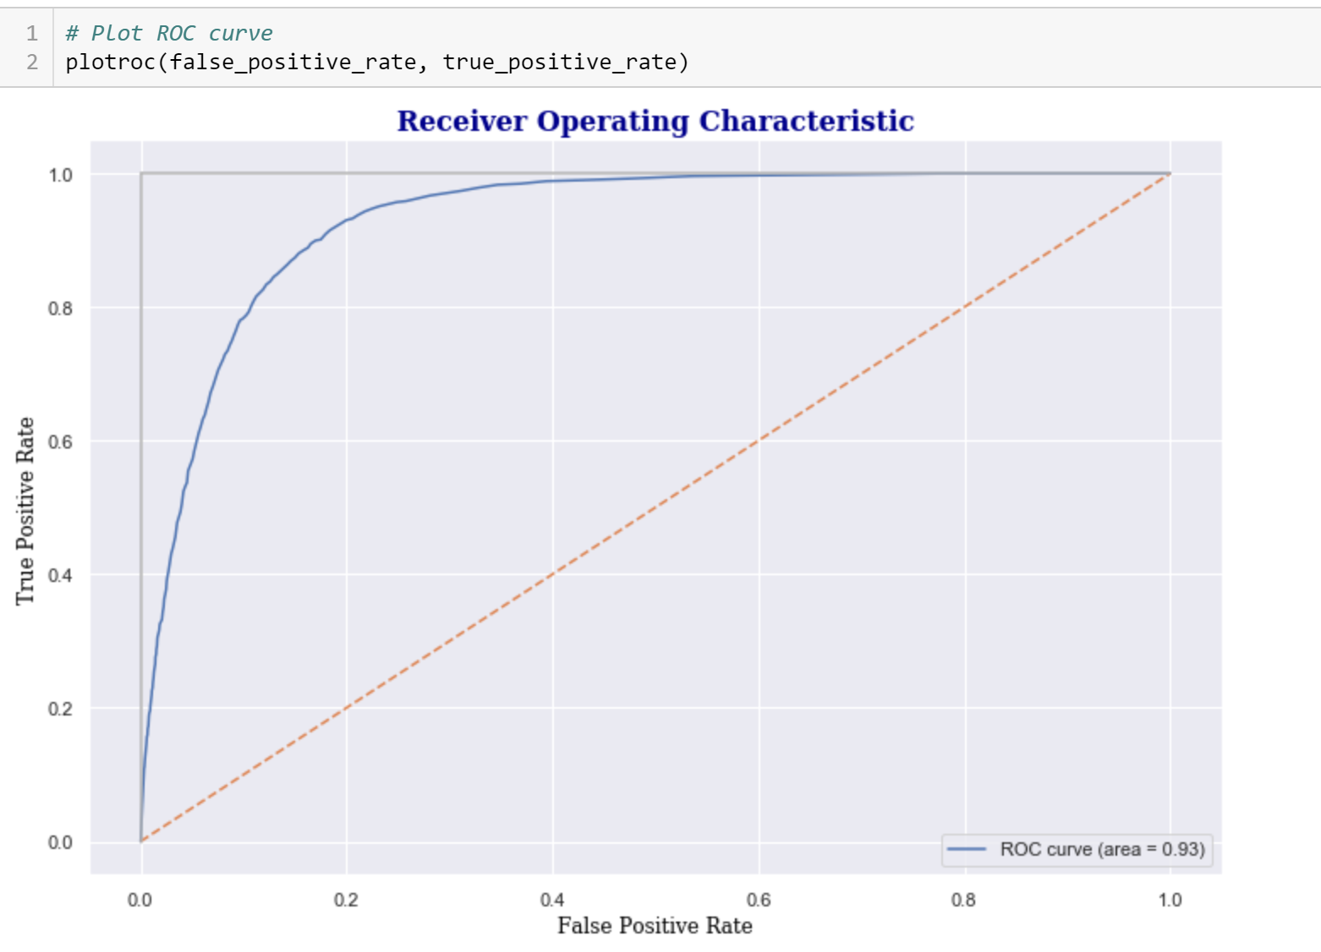

Slide 29
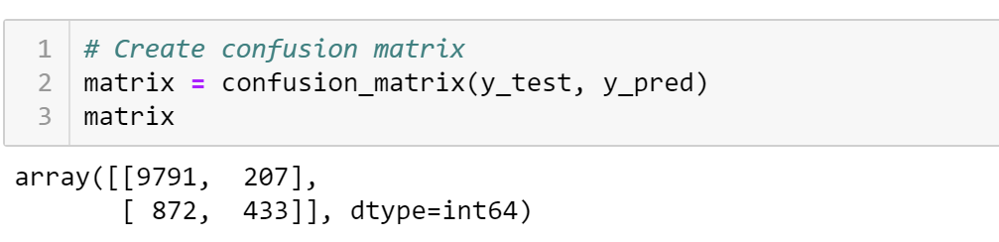
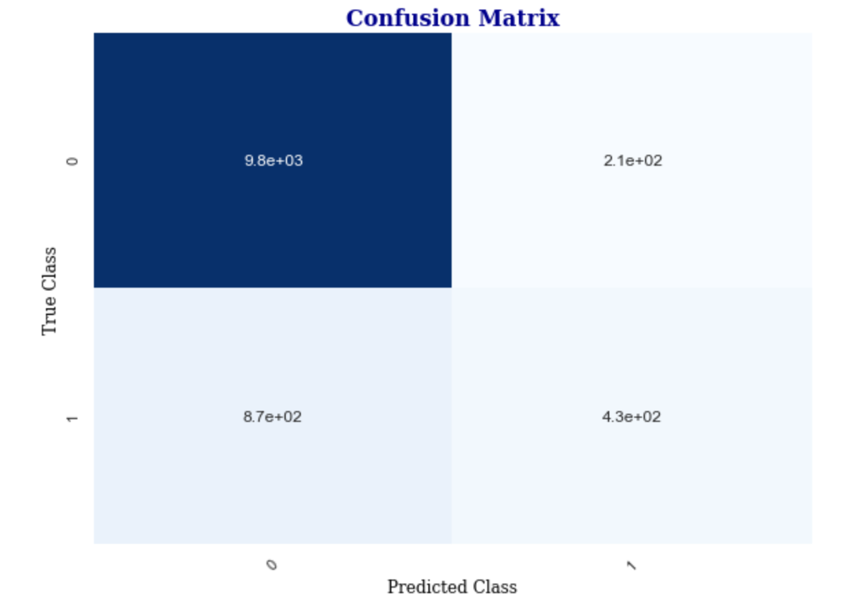

Slide 30
Model Tuning

Slide 31
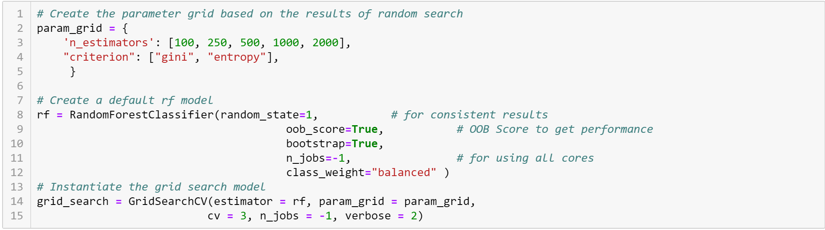
Using GridSearchCV which tries every combination of parameter given in the parameter grid, we can find out the best parameters. Though we might get better accuracy with this approach, it could lot of time to search through all parameters. So, we need to be cautious consider the tradeoff between performance and accuracy before defining the parameters for GridSearchCV.

Slide 32
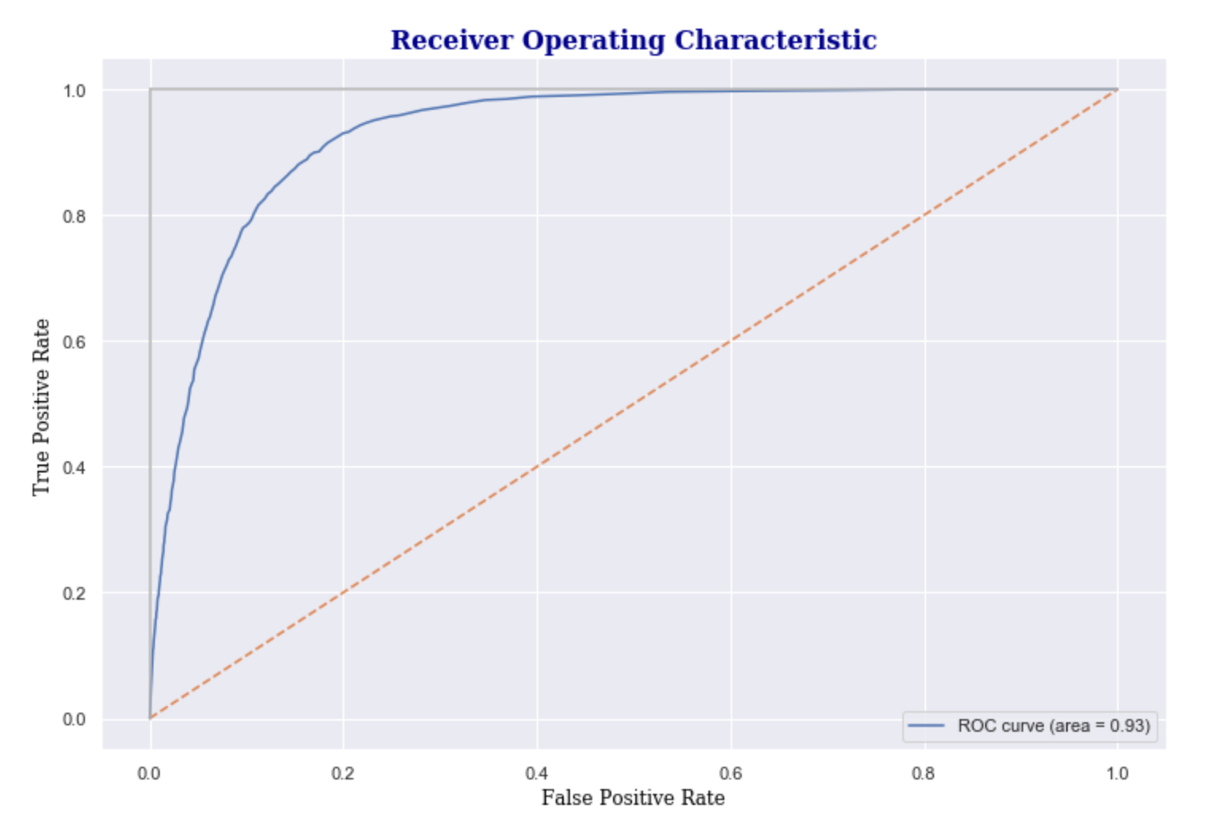

Slide 33
Model Deployment

Slide 34
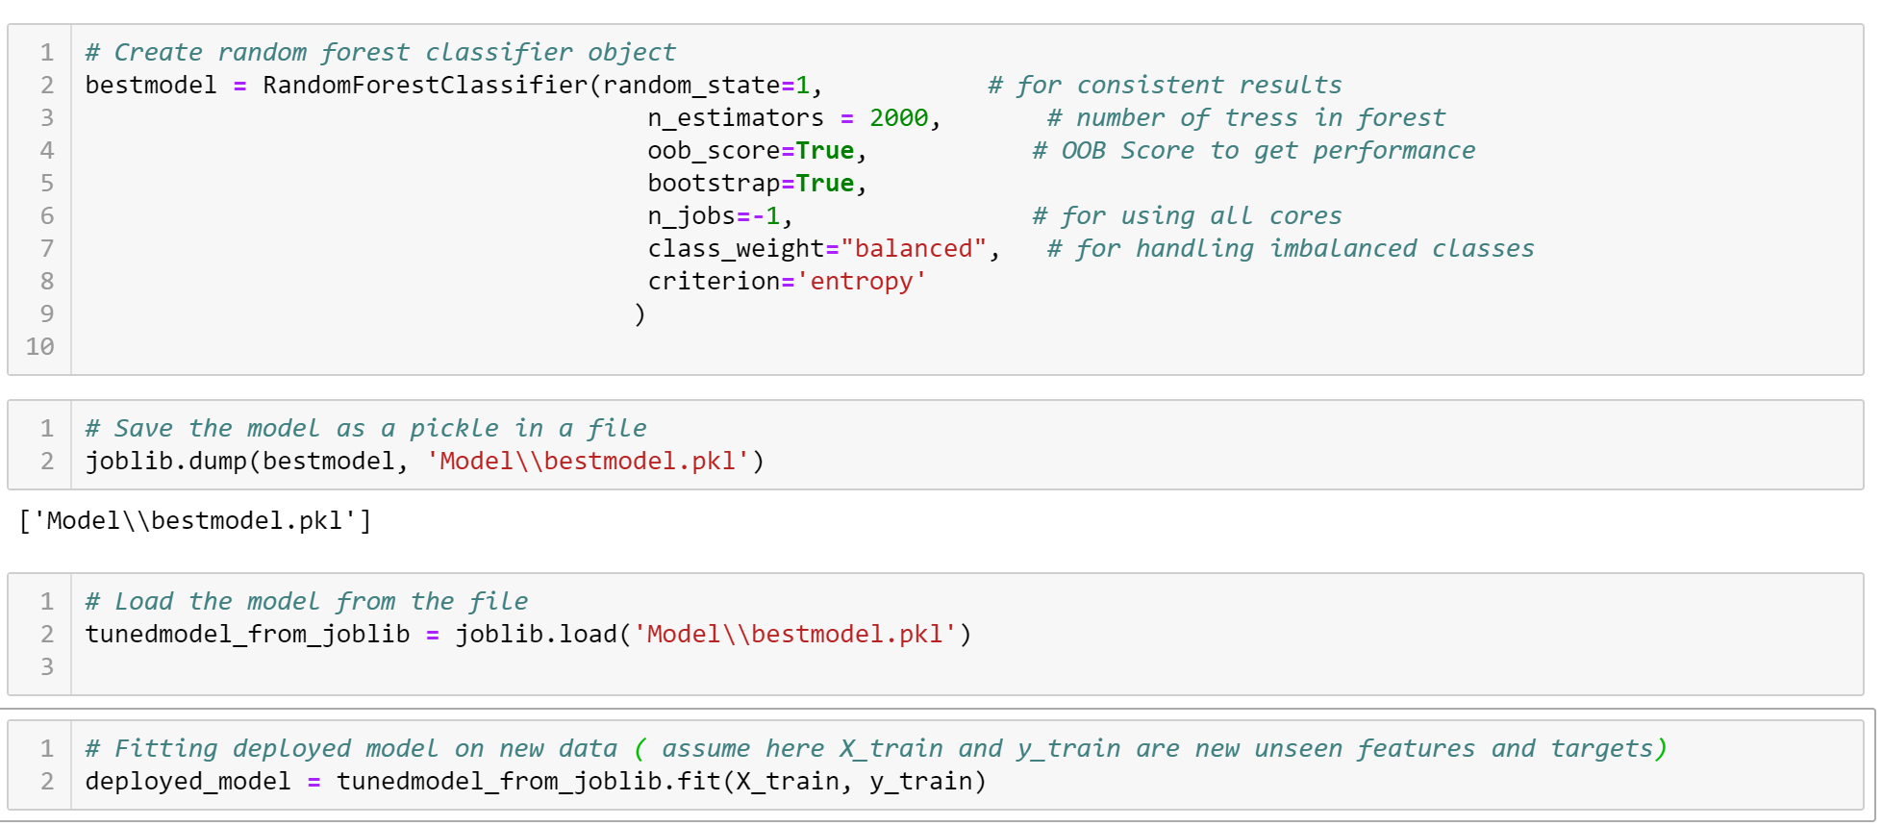
Create the model with best parameters obtained from tuning
Save the model using joblib module as a pickle
Deploy the pickle on the server and use it for fitting new unseen data

Slide 35
Conclusion
Performance of the model can be further improved upon using Deep Learning and Neural Networks.
Project Code: https://github.com/iamnrr/DSC680-Projects/tree/master/Customer%20Behaviour%20Prediction
Git Hub Portfolio: https://iamnrr.github.io/

Slide 36
Thank You

